Slide 1

Meeting 18-3-2022
Rosa Maessen

Slide 2
Progress this week
Project Proposal
Python code
09-10-2020

Slide 3
Project Proposal
Research Question
Research question:
Can skill mutation result in better performance when doing robot-to-robot learning?
Sub-questions:
How does the skill of a robot mutate during robot-to-robot learning?
Is skill mutation repeatable when using the same conditions?
What enables the mutation of the robots’ skills?
09-10-2020

Slide 4
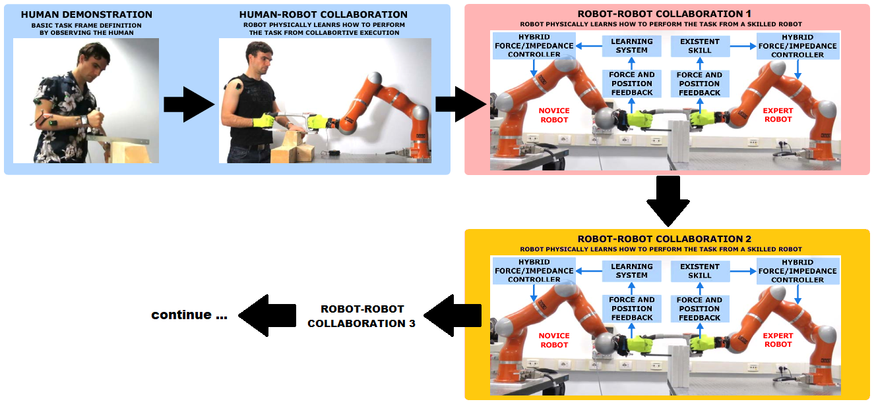
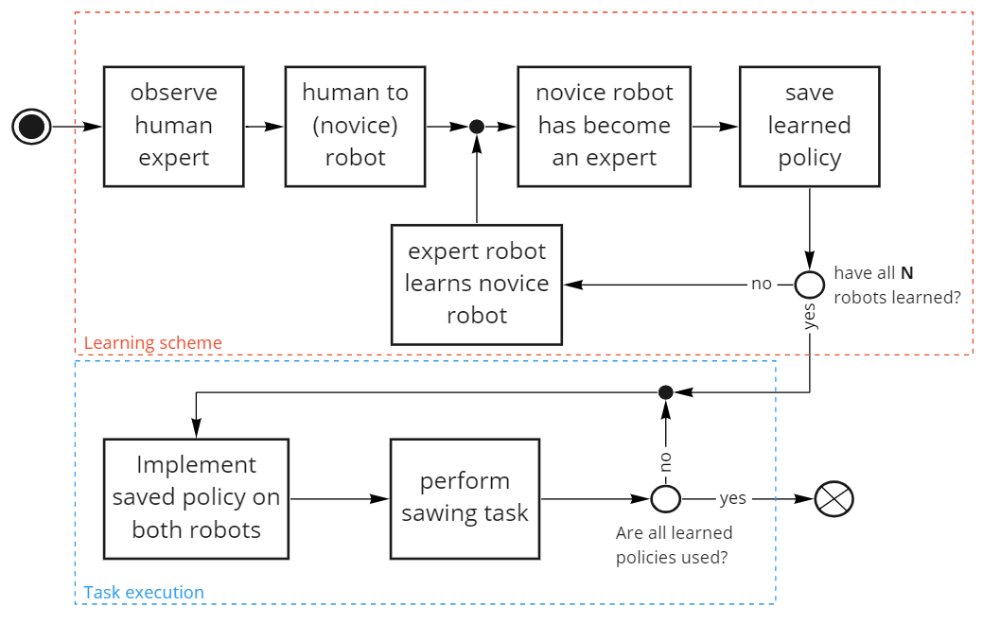
Experiment 1
09-10-2020

Slide 5
Experiment 2
Repeat experiment 1 multiple times, with the exact same conditions:
Record human demo once
Same initial conditions each trial:
Location of novice robot
Initial configuration of the robot at start of trial
End-effector position of the robot at start of trial
Robot will never let go of the saw
09-10-2020

Slide 6
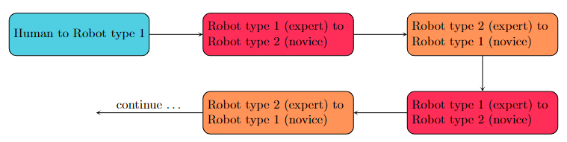
Experiment 3
Multiple conditions
Types of robot
Material
Frequency of sawing
Different demonstrations (e.g. multiple persons)
Different learning times
09-10-2020

Slide 7
Python
Implemented
Tree staged learning scheme
Step 1: Learn position
Step 2: Learn Stiffness
Step 3: Autonomously perform task
Phase determined with:
Adaptive Phase Oscillator based on Adaptive Fourier Series (learn in step 1, repeat rest of time)
Learning from expert robot (multiple times)

Slide 8
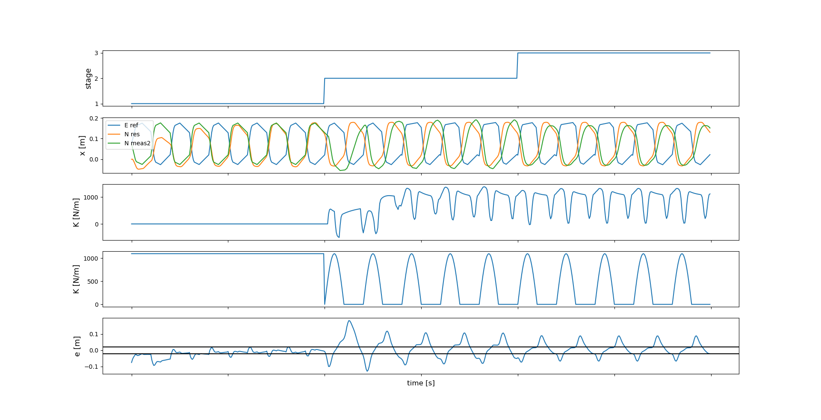
Three steps: phase in known!

Slide 9
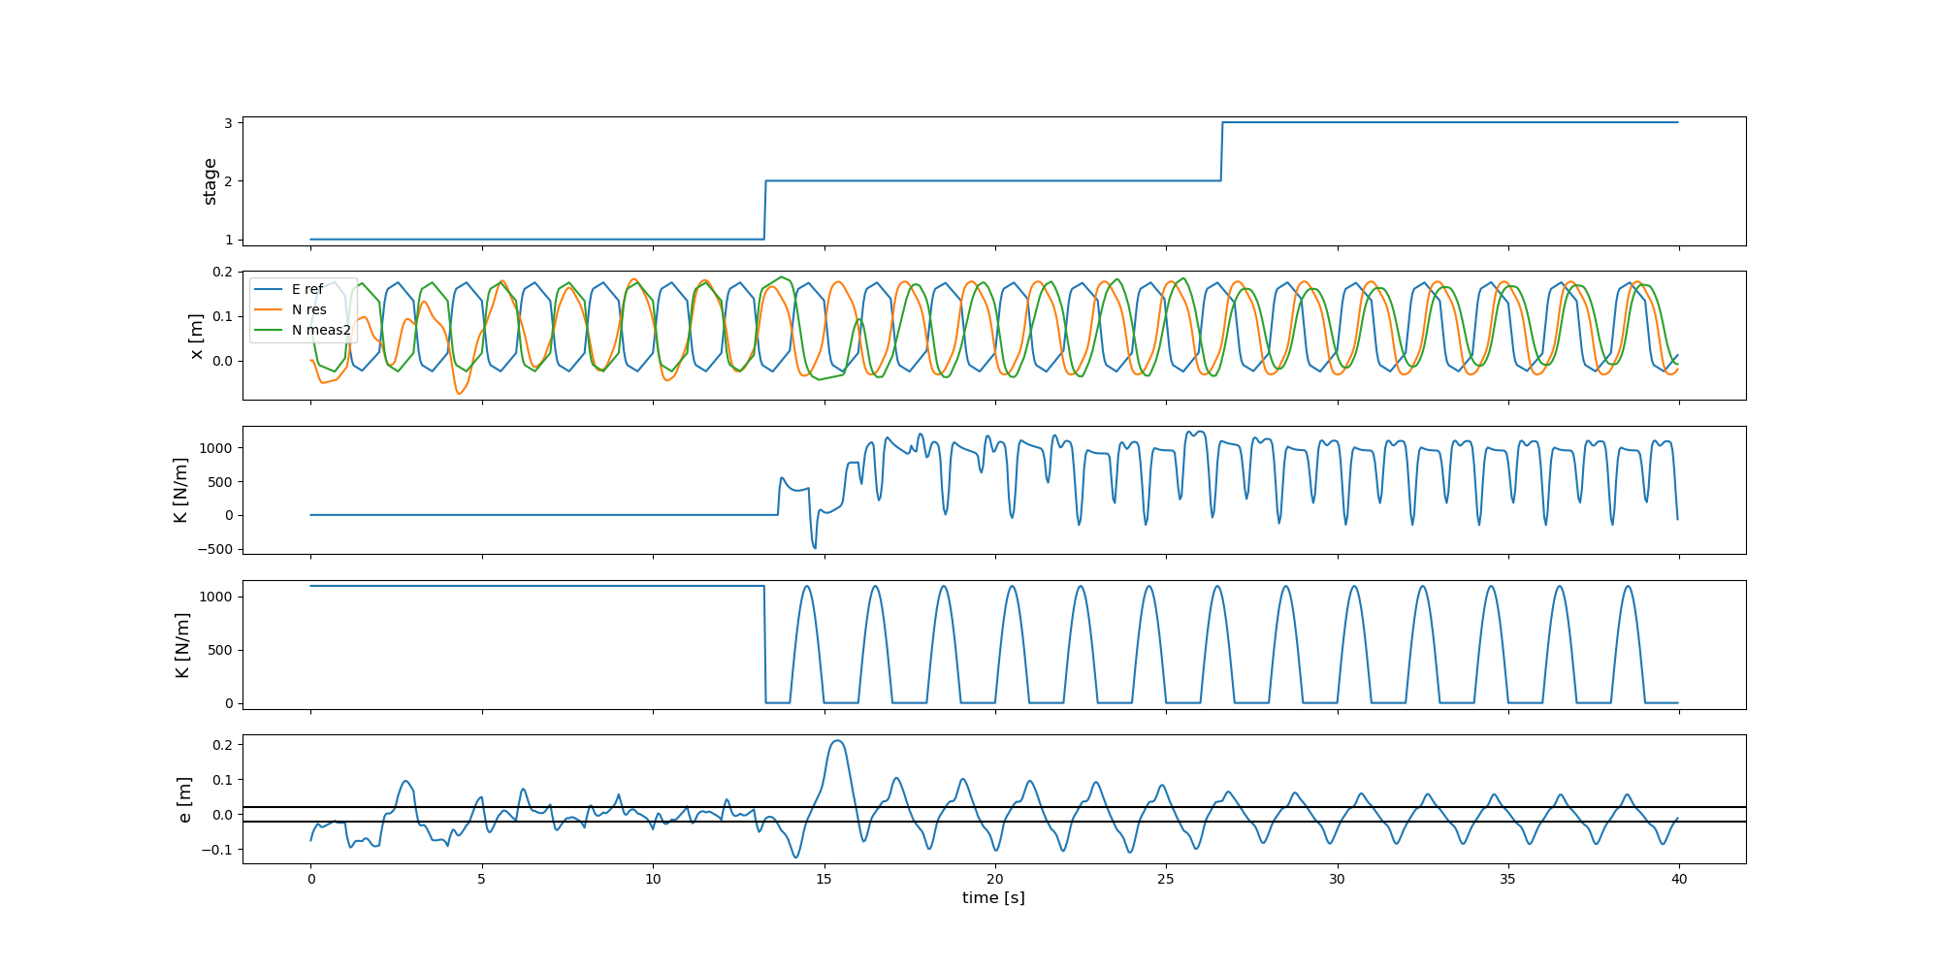
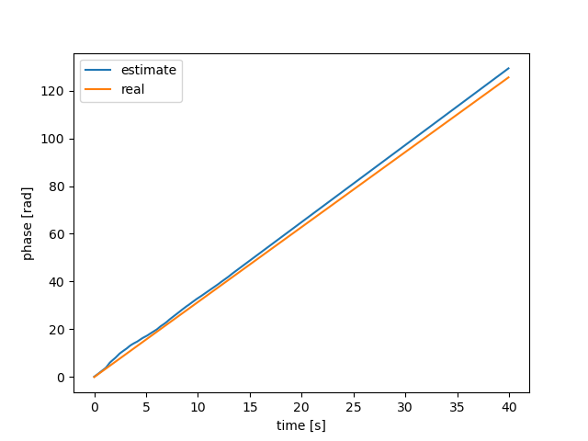
Phase computed with AFS

Slide 10
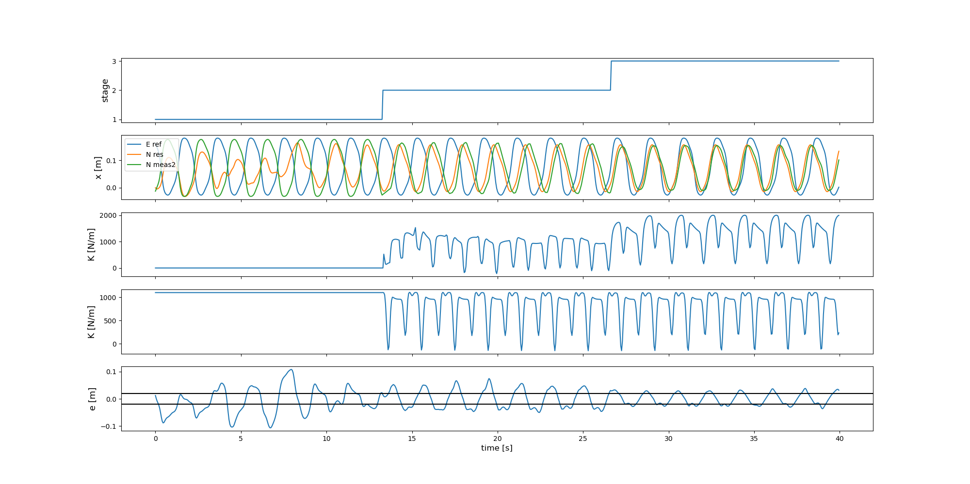
Run 2

Slide 11
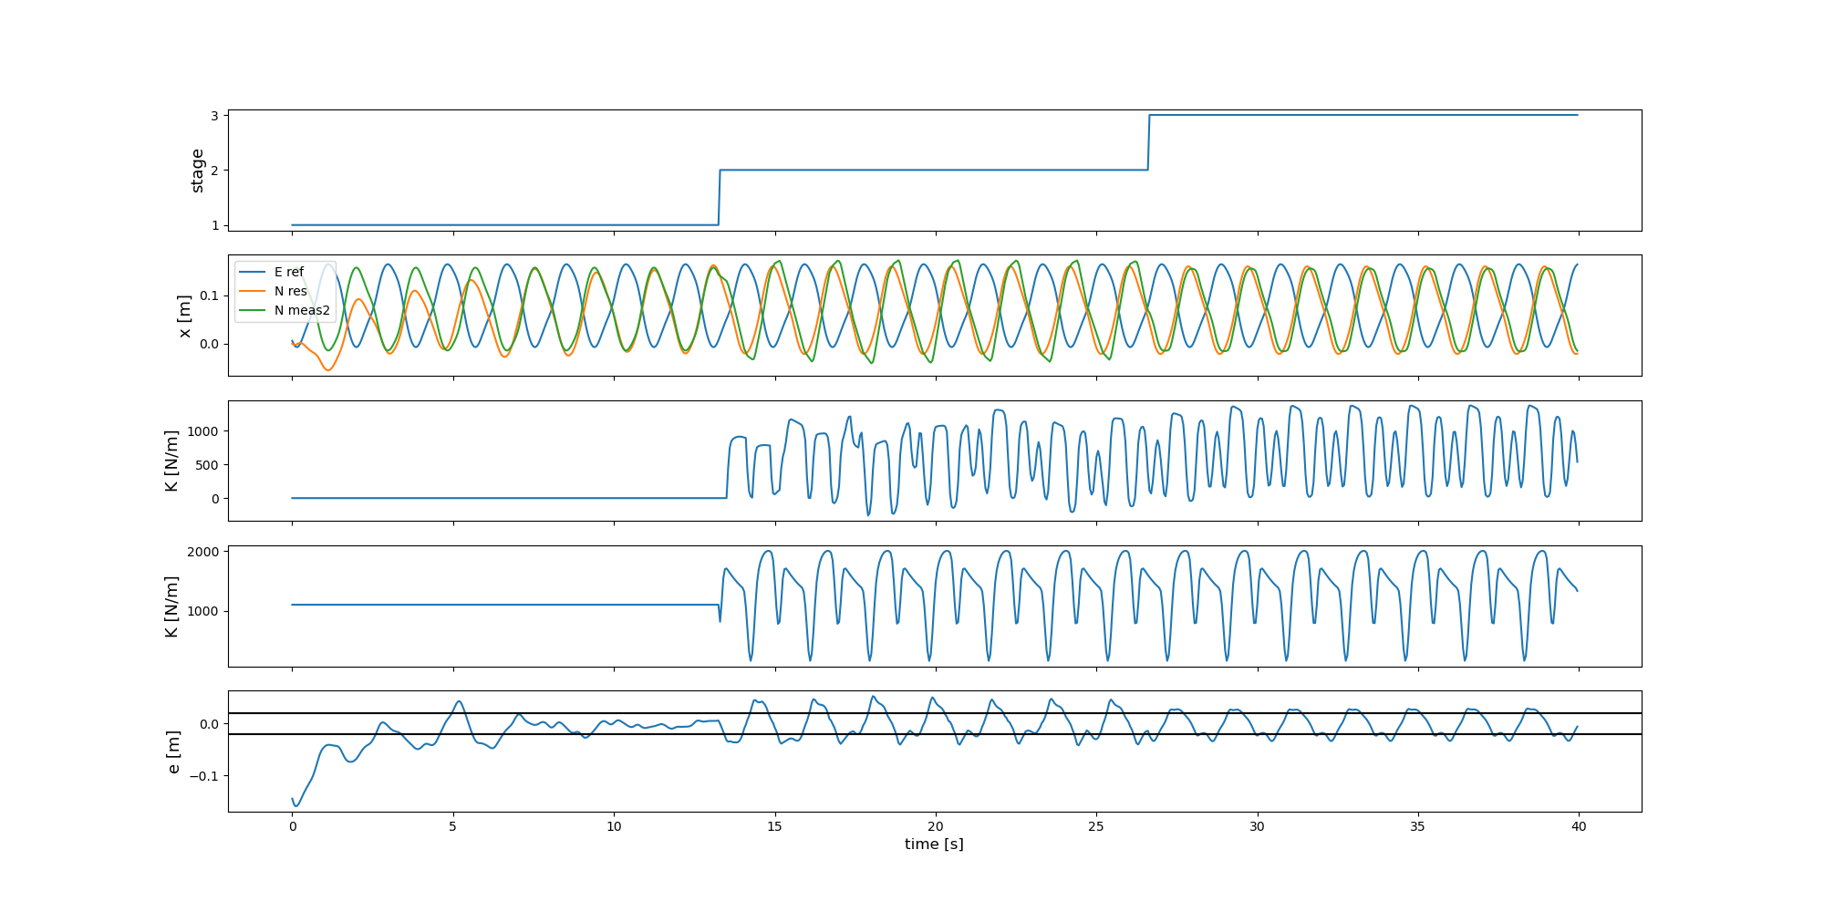
Run 3

Slide 12
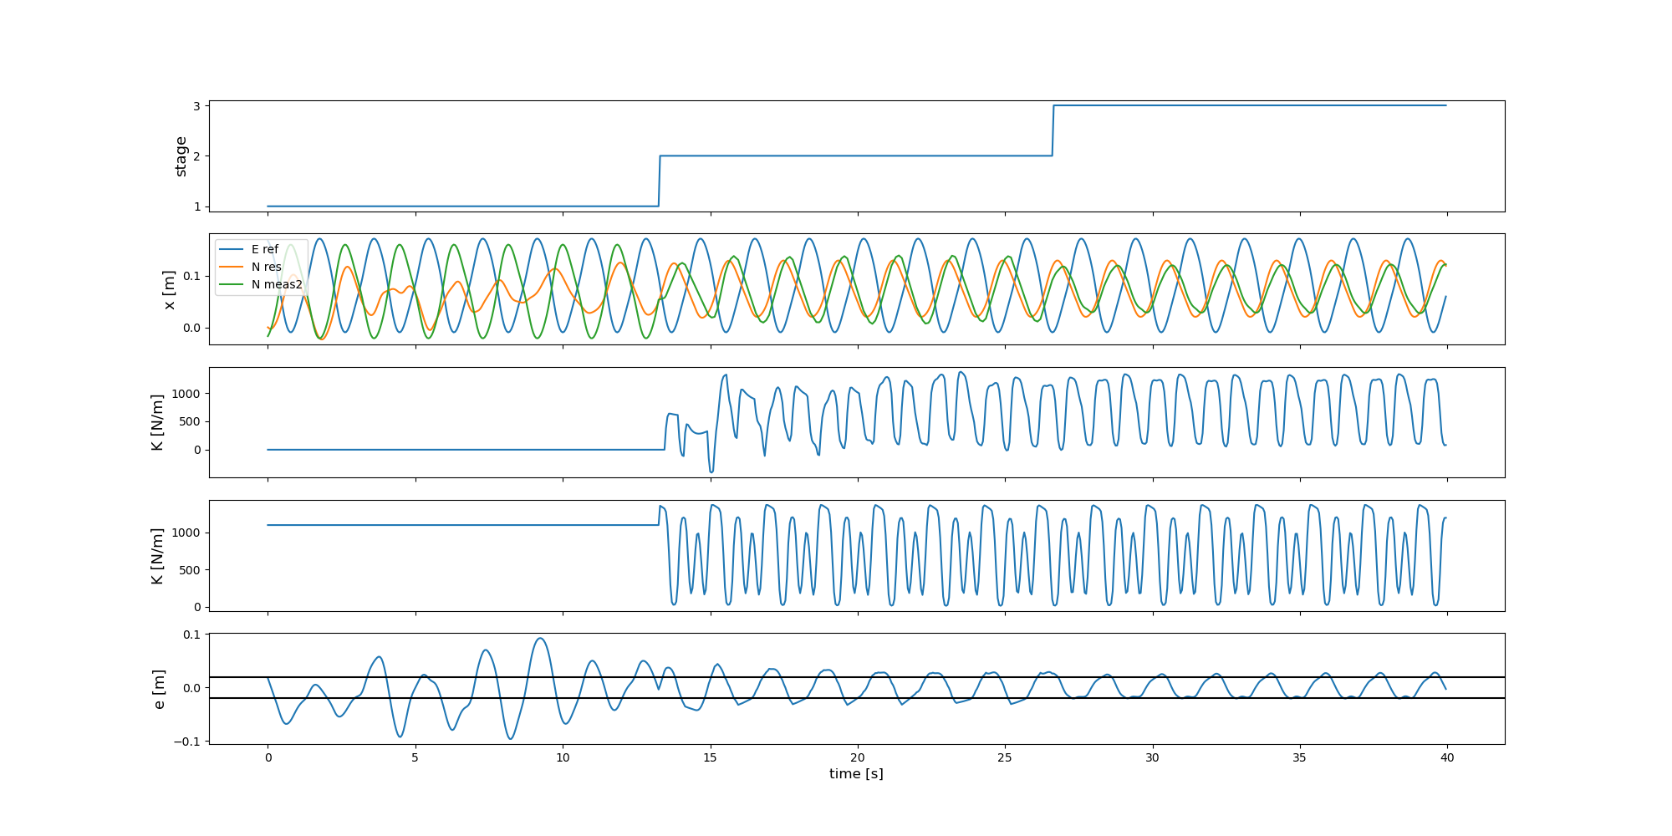
Run 4

Slide 13
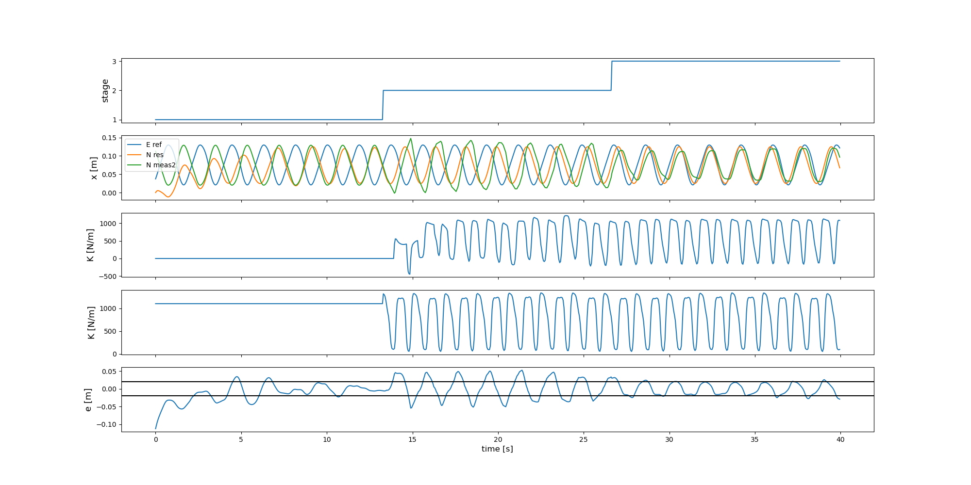
Run 5

Slide 14
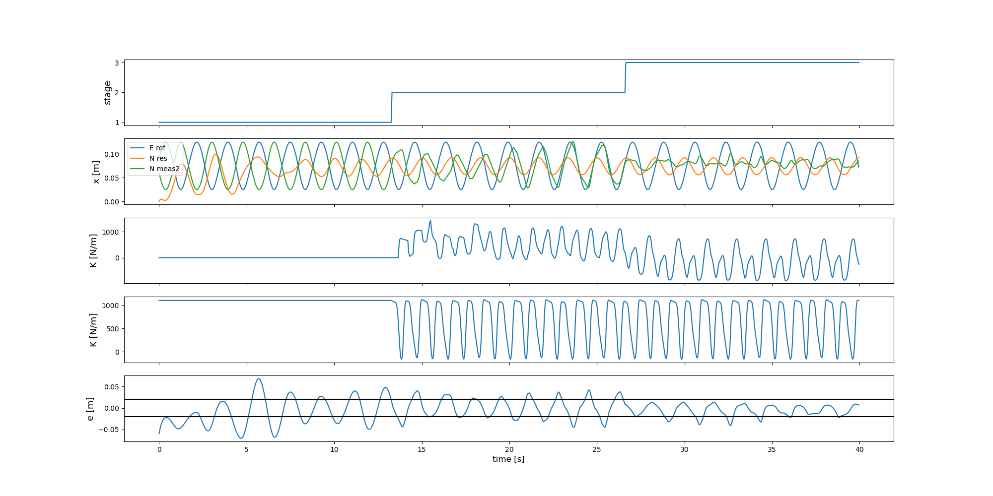
Run 6

Slide 15
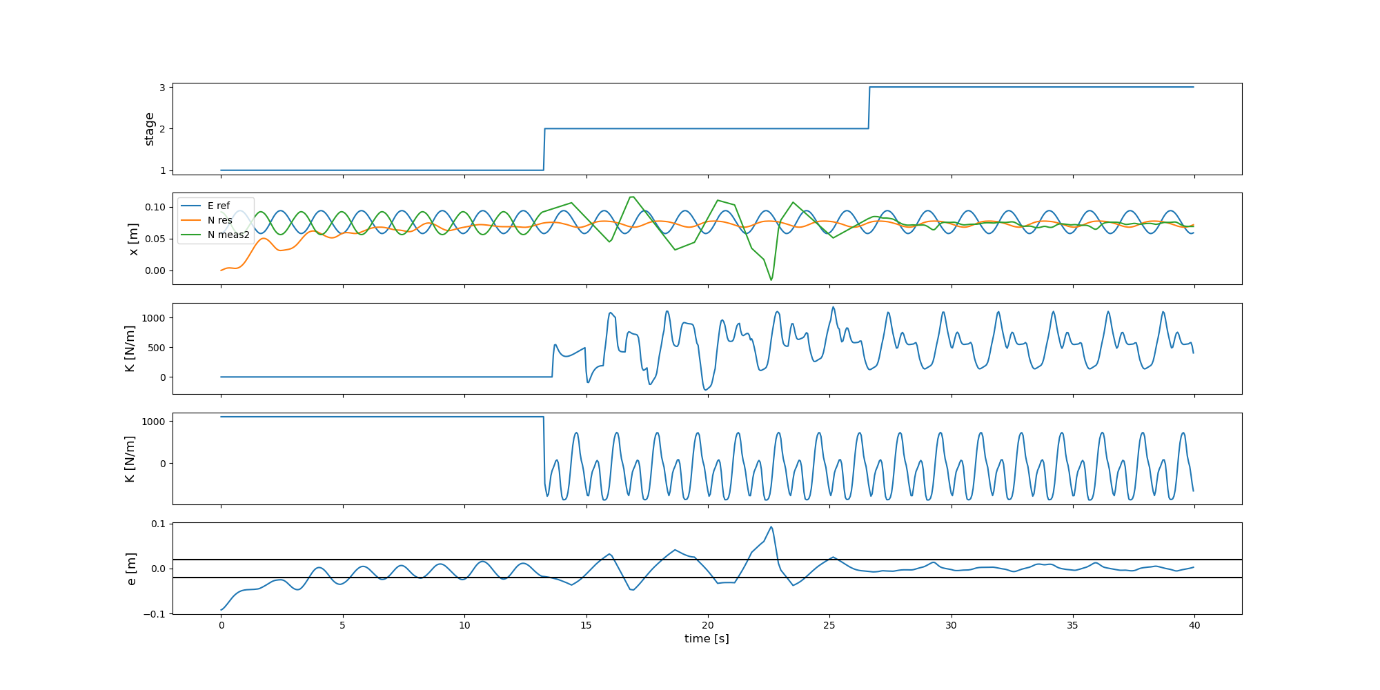
Run 7

Slide 16
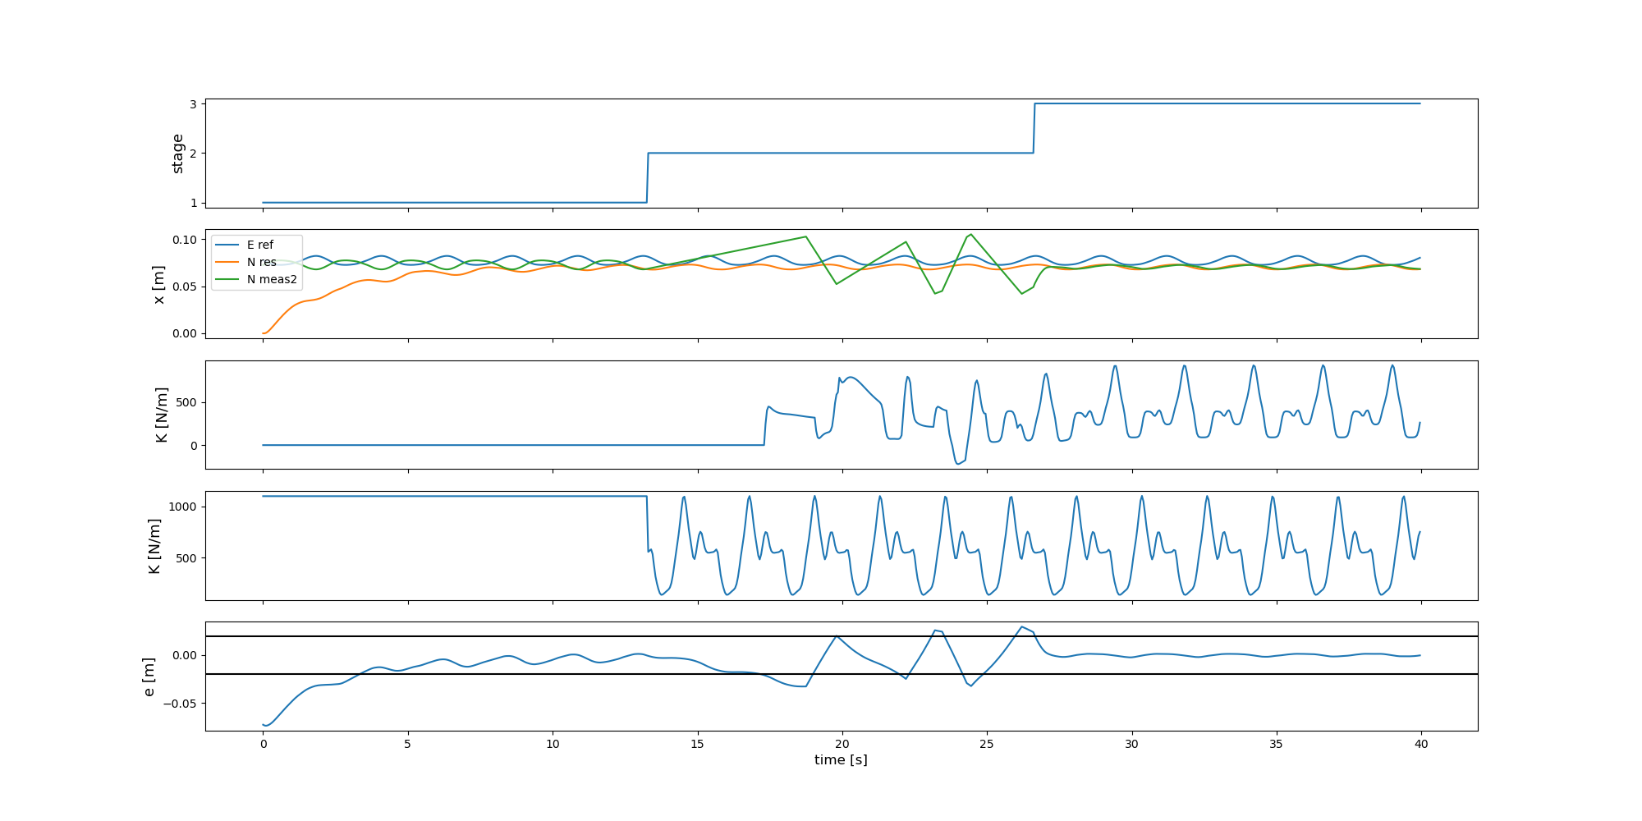
Run 8

Slide 17
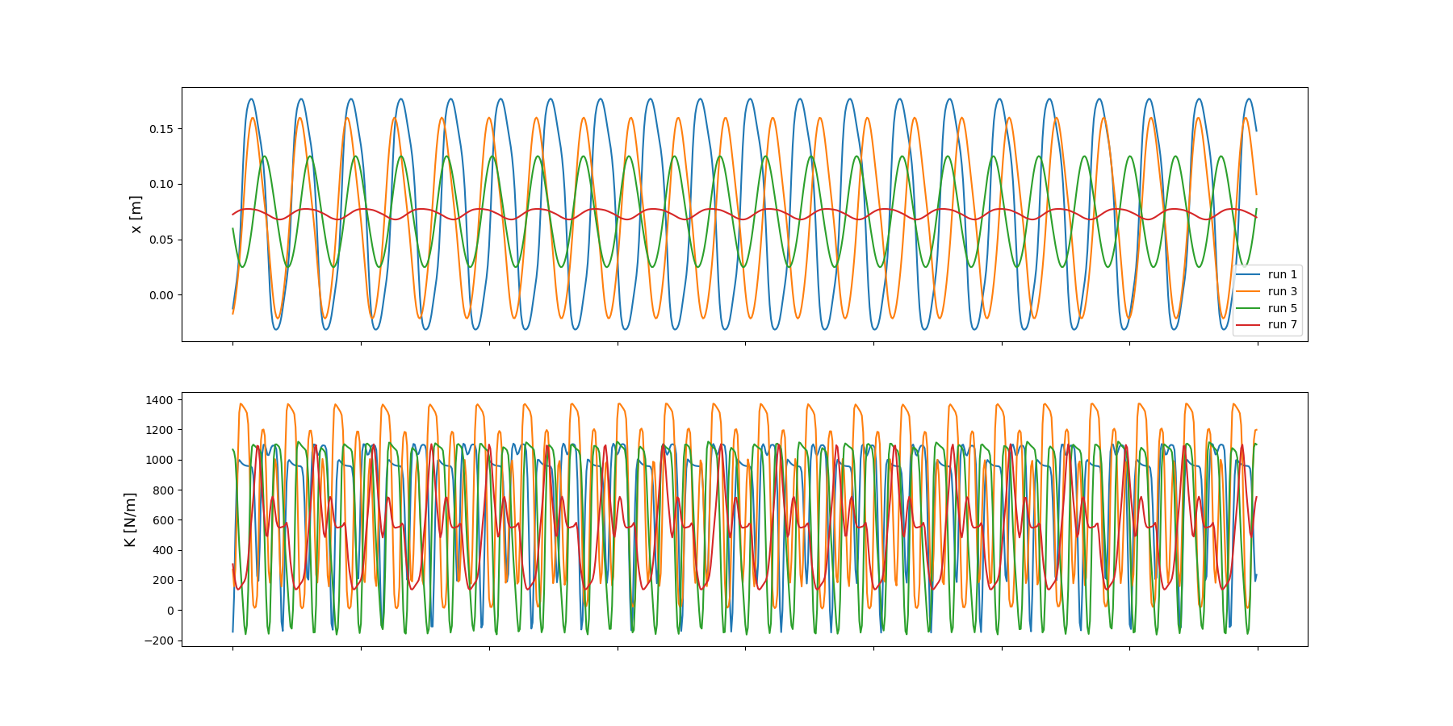
Total

Slide 18
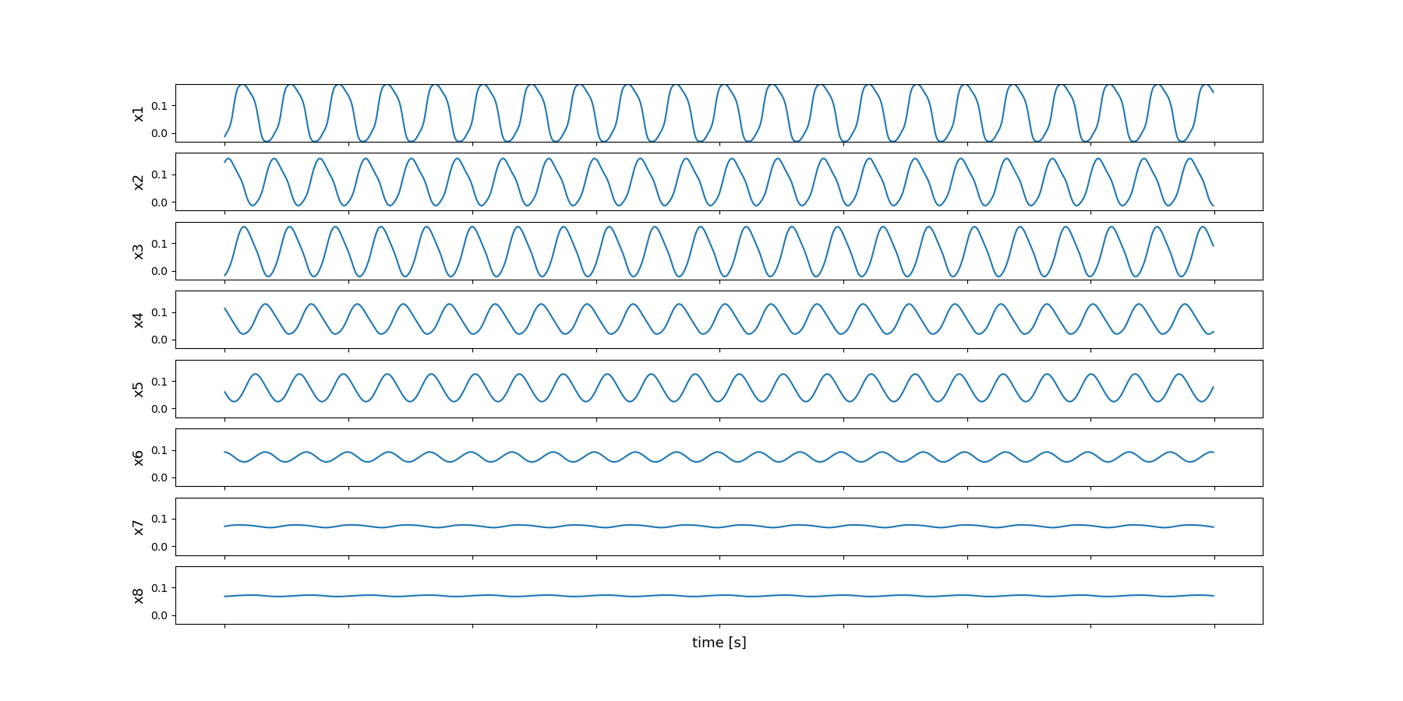
Position

Slide 19
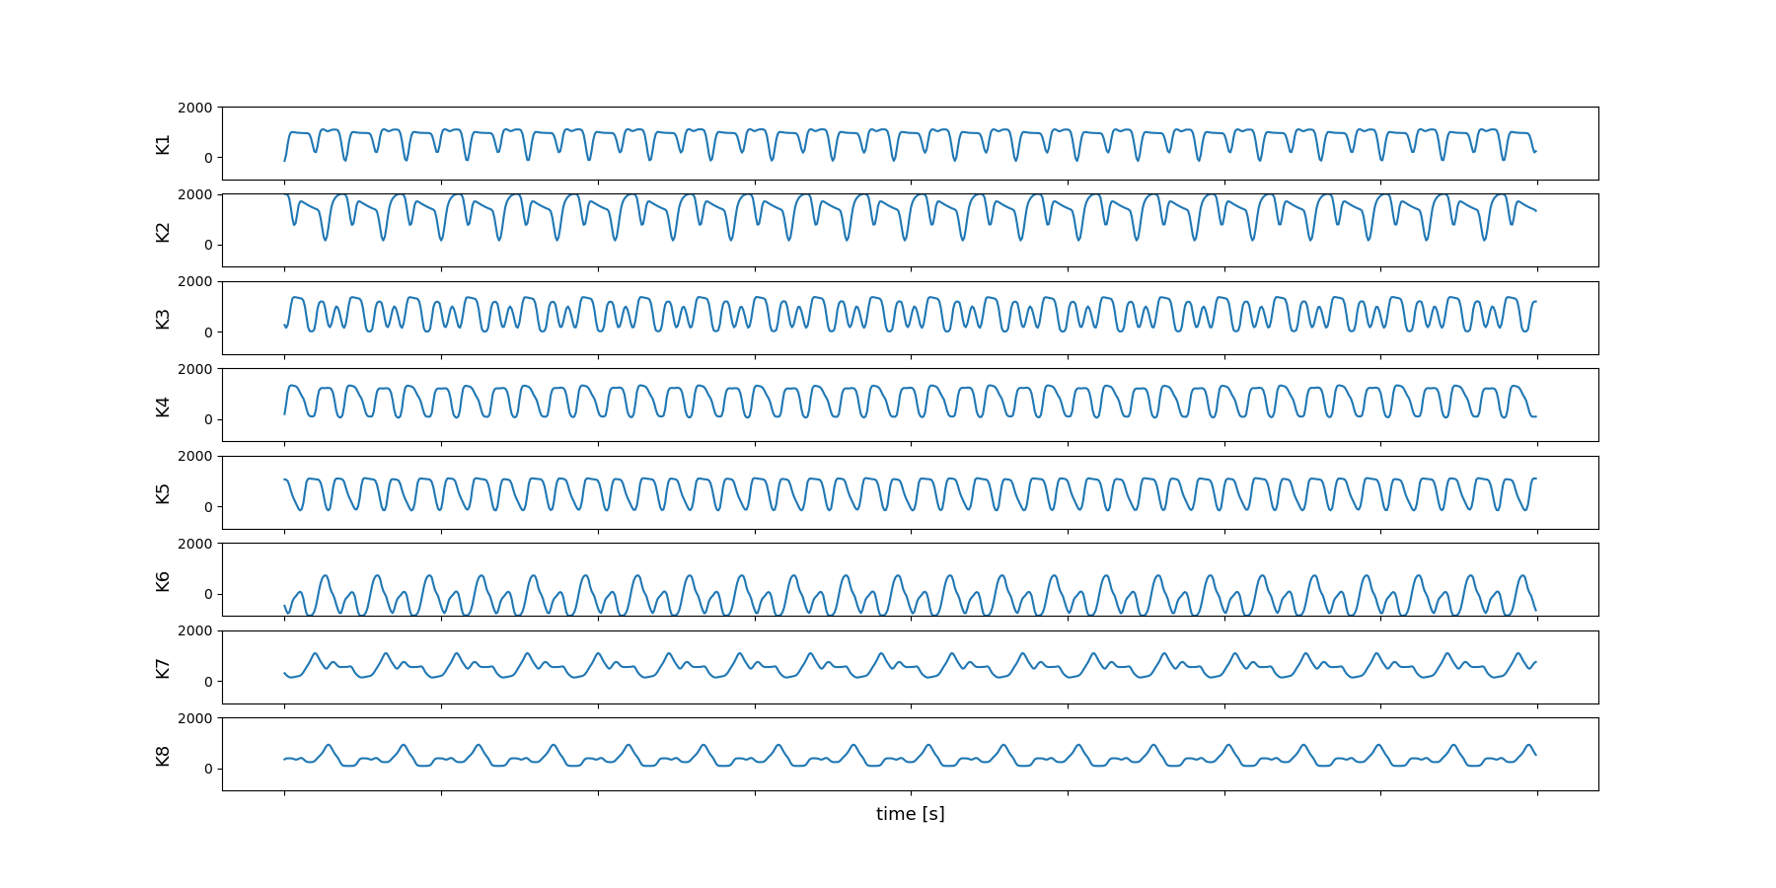
Stiffness

Slide 20
Next Step
Make sure the behavior always stayed “good”
Work on AFS -> something is not going correctly with phase
Multiple DOF
Control of robot
Working with robot? What do I have to do

Slide 21
Franka ROS Simulation
https://frankaemika.github.io/docs/franka_ros.html

